Slide 1
Customer Segmentation and CLTV Model for Bank Transactions
Abbiegael Chu
Notes:
Indian bank transactions from Kaggle

Slide 2
Business Goals
Customer Segmentation
Customer Lifetime Value Model
Customer Value Analysis
Notes:
Theme: Customer Centric Approach
Why these are important:
Targeted Marketing
Tailored marketing efforts to segmented customers could lead to higher engagement, response rates, and ROI
Customer Retention and Loyalty
Identify segments that are at risk to churn
Resource Allocation
Identify high value segments for marketing, customer service, and product development
Revenue Generation
Identify Customer Value per segment and Lifetime Value
Overall,
Segmentation, LTV, and Value analysis are all important in the decision making process for businesses. Any company will benefit in knowing their customers more

Slide 3
Original Dataset
Transaction Data
ID
Date
Time
Amount
Customer Data
ID
Date of Birth
Gender
Location
Account Balance
Transaction Data
ID
Date
Time
Amount
Notes:
Before cleaning: 1,048,567

Slide 4
Processed Dataset
Transaction Data
ID
Date
Amount
Customer Data
ID
Age
Gender
Account Balance
Notes:
Added an Age column and computed RFM
Recency – Transaction dates from January 1, 2017
Frequency – How many Transactions per Customer ID
Monetary – Sum of all Transaction Amounts by Customer ID
After cleaning:
Total customers: 901,383

Slide 5
Techniques Used
Customer Segmentation
Elbow Method
K Means Clustering
CLTV
Linear Regression
Decision Tree
Random Forest
Notes:
K-means clustering is an unsupervised machine learning algorithm used to partition a dataset into k clusters.
Linear Regression – Statistical modelling technique used to see relationship of independent and dependent variables
Decision Tree – Tree-like structure to make decisions based on features
Random Forest – Multiple decision trees with small differences

Slide 6
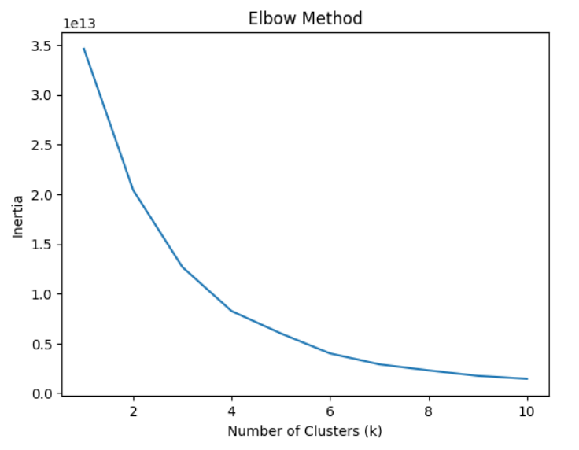
Results: Customer Segmentation
4
Number
of Clusters
Notes:
Features used were Recency, Frequency, and Monetary Value
Recency – Transaction dates from January 1, 2017
Frequency – How many Transactions per Customer ID
Monetary – Sum of all Transaction Amounts by Customer ID

Slide 7



Results: Customer Segmentation
 | A | B | C | D
Recency | - | - | -
Frequency |  | -
Monetary | -
Notes:
Cluster A: Moderate Recency, Low Frequency, Low-Moderate Monetary Value
Cluster B: Moderate-High Recency, Medium Frequency, High Monetary Value
Cluster C: Moderate-High Recency, High Frequency, High Monetary Value
Cluster D: High Recency, High Frequency, Very High Monetary Value

Slide 8
Results: Customer Segmentation
D
27
B
1,227
C
15,407
A
A
884,722
Notes:
Total customers: 901,383

Slide 9
Results: Customer Value Analysis

Slide 10
Results: Customer Lifetime Value
Recency
Monetary
Account
Balance
Age
1
3
5
7
2
4
6
Frequency
Gender
Transaction Amount
Notes:
Features used in the models

Slide 11
Results: Customer Lifetime Value
 | Linear Regression | Decision Tree | Random Forest
Mean Squared Error | 1,785,030,180 | 487,006,820 | 327,178,248
Mean Absolute Error | 7,838 | 146 | 142
R-squared Score | 0.9098 | 0.9754 | 0.9835
Notes:
Average squared difference between predicted and actual CLTV
Lower MSE indicates better prediction accuracy
The MAE represents the average absolute difference between the predicted CLTV values and the actual CLTV values.
Lower MAE indicates better prediction accuracy
The R-squared score measures the proportion of variance in the CLTV that can be explained by the linear regression model.
A higher R-squared score indicates a better fit of the regression model to the data.
Linear Regression – Statistical modelling technique used to see relationship of independent and dependent variables
Decision Tree – Tree-like structure to make decisions based on features
Random Forest – Multiple decision trees with small differences

Slide 12
Conclusion
Notes:
Segmentation – Only Cluster A was identified to have low frequency and monetary value. So we might need to keep a closer eye on this group, since they make up 68% of monetary contribution for the bank.
Customer Value – Cluster D has 27 customers, and this cluster makes up 1% of revenue. While Cluster A has more than 800k people, with an average value of around 1k each.
CLTV – Random Forest Model

Slide 13
Thanks!

